Slide 1
Deep Neural Networks: Assorted Topics and Some Recent Advances
CS771: Introduction to Machine Learning
Piyush Rai

Slide 2
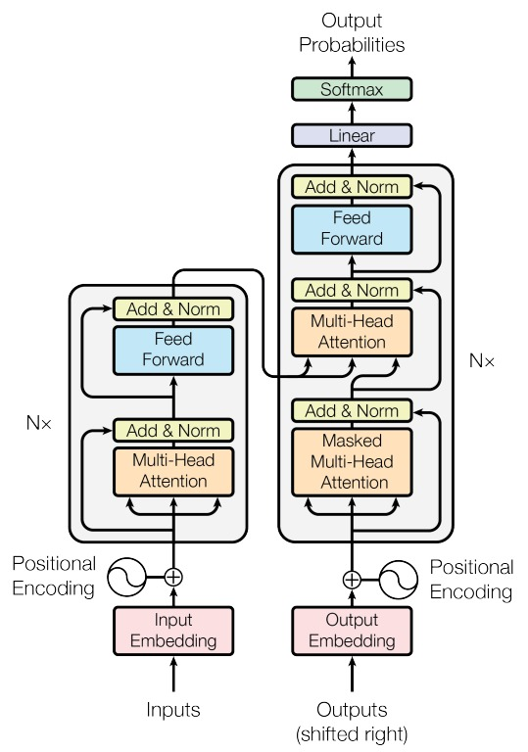


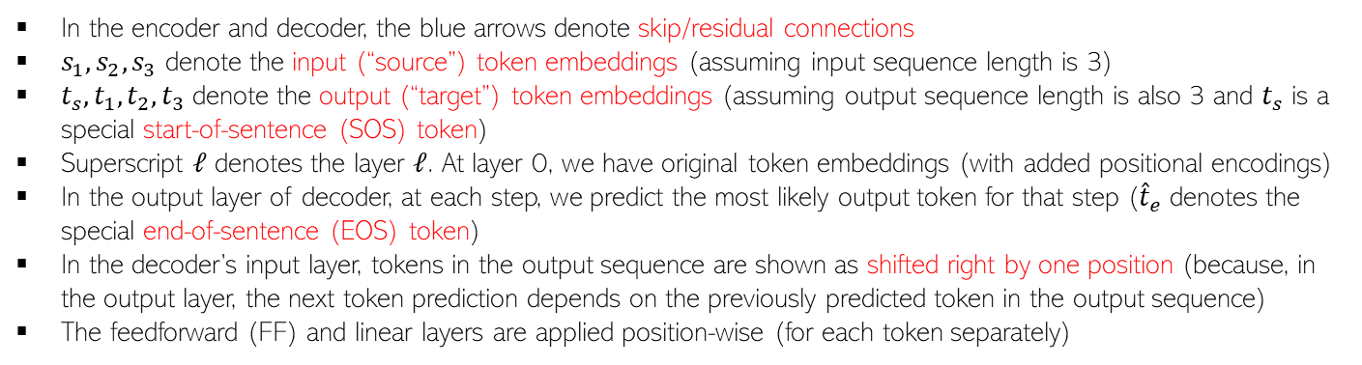














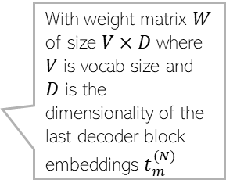







Transformers (recap)
2
In the encoder and decoder, the blue arrows denote skip/residual connections
$s_{1},s_{2},s_{3}$ denote the input (“source”) token embeddings (assuming input sequence length is 3)
$t_{s},t_{1},t_{2}, t_{3}$ denote the output (“target”) token embeddings (assuming output sequence length is also 3 and $t_{s}$ is a special start-of-sentence (SOS) token)
Superscript $ℓ$ denotes the layer $ℓ$. At layer 0, we have original token embeddings (with added positional encodings)
In the output layer of decoder, at each step, we predict the most likely output token for that step (${\hat{t}}_{e}$ denotes the special end-of-sentence (EOS) token)
In the decoder’s input layer, tokens in the output sequence are shown as shifted right by one position (because, in the output layer, the next token prediction depends on the previously predicted token in the output sequence)
The feedforward (FF) and linear layers are applied position-wise (for each token separately)
$$t_{s}^{(ℓ)}$$
$$t_{1}^{(ℓ)}$$
$$t_{2}^{(ℓ)}$$
$$t_{3}^{(ℓ)}$$
$${\hat{t}}_{m}^{(N)}= {argmax}_{i=1,…, V} softmax(Wt_{m}^{(N)})$$
$$s_{1}^{(ℓ)}$$
$$s_{2}^{(ℓ)}$$
$$s_{3}^{(ℓ)}$$
Layer Normalization
$${\hat{t}}_{1}^{(N)}$$
$${\hat{t}}_{2}^{(N)}$$
$${\hat{t}}_{3}^{(N)}$$
$${\hat{t}}_{e}^{(N)}$$
Note the one position (towards right) shift between decoder’s input vs output
FF
FF
FF
FF
Layer Normalization
Layer Normalization
Softmax
Softmax
Softmax
Softmax
With weight matrix $W$ of size $V×D$ where $V$ is vocab size and $D$ is the dimensionality of the last decoder block embeddings $t_{m}^{(N)}$
Overall Transformer
Architecture
FF
FF
FF
Cross-Attention Layer
Linear
Linear
Linear
Linear
Each FF (feed-forward)in encoder and decoder blocks is usually a linear layer + ReLU nonlinearity + another linear layer
Layer Normalization
Layer Normalization
$$t_{s}^{(N)}$$
$$t_{1}^{(N)}$$
$$t_{2}^{(N)}$$
$$t_{3}^{(N)}$$
Self-Attention Layer
Masked Self-Attention Layer
Decoder’s output layer
$$s_{1}^{(ℓ−1)}$$
$$s_{2}^{(ℓ−1)}$$
$$s_{3}^{(ℓ−1)}$$
$$t_{s}^{(ℓ−1)}$$
$$t_{1}^{(ℓ−1)}$$
$$t_{2}^{(ℓ−1)}$$
$$t_{3}^{(ℓ−1)}$$
An Encoder Block
(N such blocks)
A Decoder Block connected with the corresponding encoder block
(N such blocks)

Slide 3
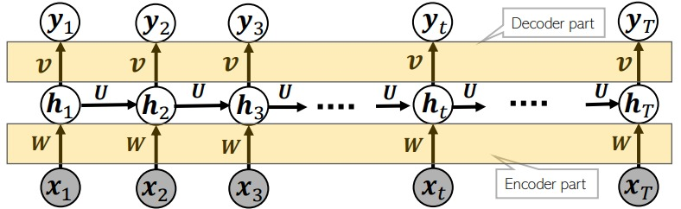

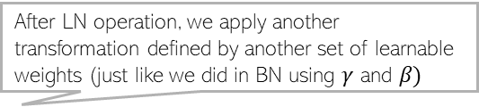
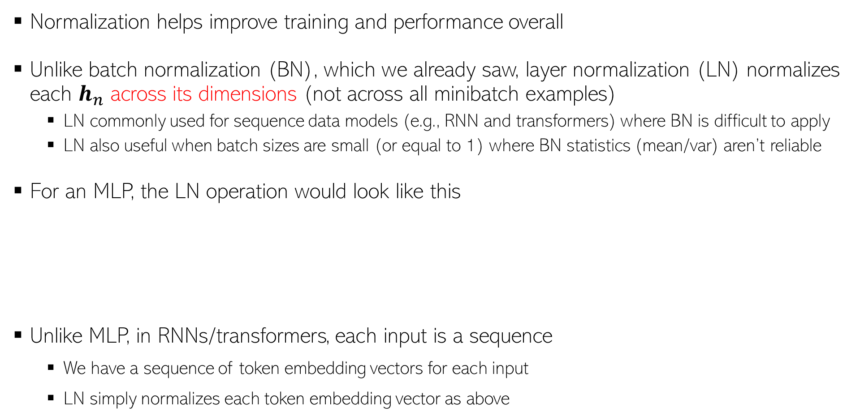


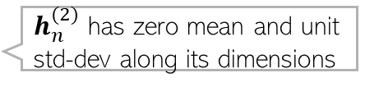




Layer Normalization
3
Normalization helps improve training and performance overall
Unlike batch normalization (BN), which we already saw, layer normalization (LN) normalizes each $h_{n}$ across its dimensions (not across all minibatch examples)
LN commonly used for sequence data models (e.g., RNN and transformers) where BN is difficult to apply
LN also useful when batch sizes are small (or equal to 1) where BN statistics (mean/var) aren’t reliable
For an MLP, the LN operation would look like this
Unlike MLP, in RNNs/transformers, each input is a sequence
We have a sequence of token embedding vectors for each input
LN simply normalizes each token embedding vector as above
After LN operation, we apply another transformation defined by another set of learnable weights (just like we did in BN using $γ$ and $β)$
$$h_{n}^{(2)}$$
$$h_{n}^{(2)}$$
$h_{n}^{(2)}$ has zero mean and unit std-dev along its dimensions
0.1
0.8
0.3
-1.02
1.36
-0.34
After LN
$$h_{n}^{(1)}$$
0.5
0.9
0.7
$$h_{n}^{(1)}$$
-1.22
1.22
0.0
$h_{n}^{(1)}$ has zero mean and unit std-dev along its dimensions
$$x_{n}$$
$$x_{n}$$

Slide 4
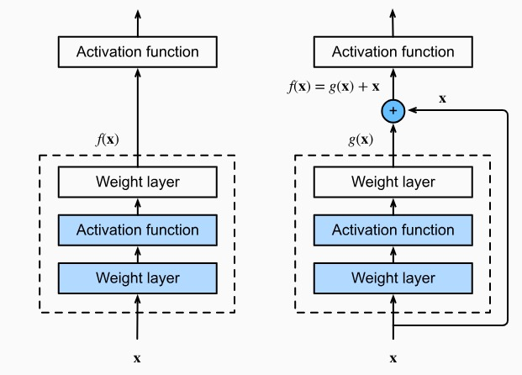
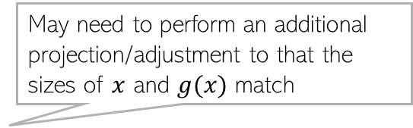
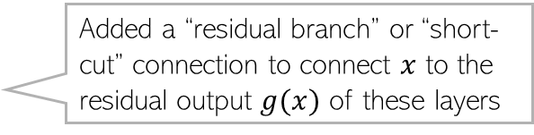
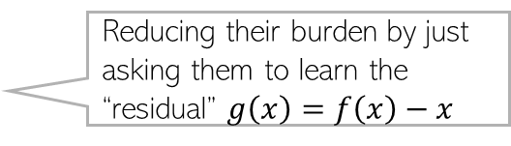
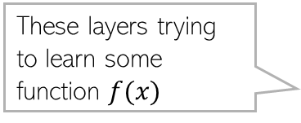
Residual/Skip Connections
4
Transformers (and many other modern deep nets) contain a very large number of layers
In general, just stacking lots of layer doesn’t necessarily help a deep learning model
Vanishing/exploding gradient may make learning difficult
Skip connections or “residual connections” help if we want very deep networks
This idea was popularized by “Residual Networks”* (ResNets) which can have hundreds of layers
Basic idea: Don’t force a layer to learn everything about a mapping
May need to perform an additional projection/adjustment to that the sizes of $x$ and $g(x)$ match
Added a “residual branch” or “short-cut” connection to connect $x$ to the residual output $g(x)$ of these layers
These layers trying to learn some function $f(x)$
Reducing their burden by just asking them to learn the “residual” $g\left(x\right)=f\left(x\right)−x$
*Deep Residual Learning for Image Recognition (He et al, 2015)

Slide 5
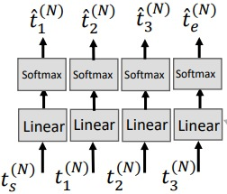
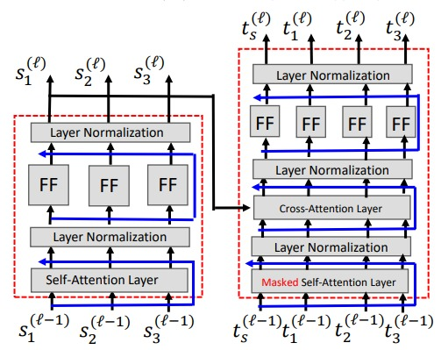
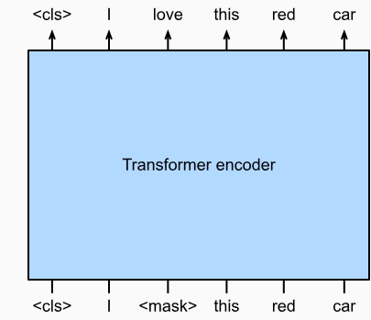
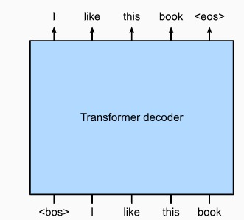
Transformers have many variants
5
The standard transformer architecture is an encoder-decoder model
Some models use just the encoder or the decoder of the transformer
BERT (Bidirectional Encoder Representations from Transformers)
Basic BERT can be learned to encoder token sequences
GPT (Generative Pretrained Transformer)
Basic GPT can be used to generate token sequences similar to its training data
Encoder
Decoder
This encoder can be used for other tasks by fine-tuning
Also, no cross-attention since there is no encoder
A transformer which contains only the decoder
A transformer which contains only the encoder
BERT
GPT
Pre-trained using a next token prediction objective
Trained unsupervisedly using a missing token prediction objective
This is just start of sentence token
Missing token which BERT tries to predict

Slide 6
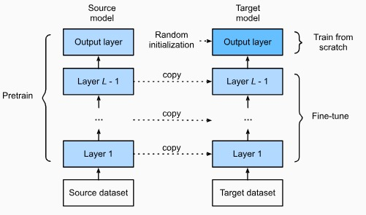
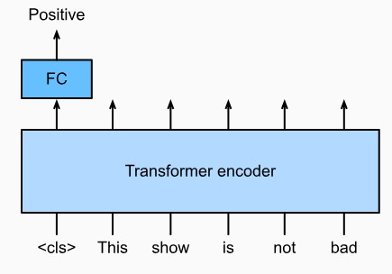
Fine-tuning and Transfer Learning
6
Deep neural networks trained on one dataset can be reused for another dataset
It is like transferring the knowledge of one learning task to another learning task
This is typically done by “freezing” most of the lower layers and finetuning the output layer (or the top few layers) – this is known as “fine-tuning”
Initial model with frozen layers is called the “pre-trained” model and the updated model is called the “fine-tuned” model
BERT (pre-trained in unsupervised manner) fine-tuned for a sentence classification task by adding a fully connect MLP to predict class-label of a sentence
This example is for an MLP like architecture but fine-tuning can be done for other architectures as well, such as RNN, CNN, transformers, etc
Figure source: Dive into Deep Learning (Zhang et al, 2023)

Slide 7
Unsupervised Pre-training
7
Self-supervised learning is a powerful idea to learn good representations unsupervisedly
Self-supervised learning is key to unsupervised pre-training of deep learning models
Such pre-trained models can be fine-tuned for any new task given labelled data
Models like BERT, GPT are usually pre-trained using self-supervised learning
Then we can finetune them further for a given task using labelled data for that task
Self-supervised learning will help us learn a good encoder (feature representation)
Hide part of the input and predict it using the remaining parts

Slide 8
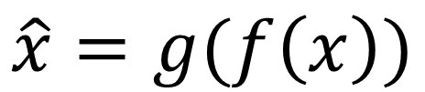

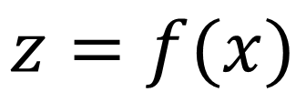
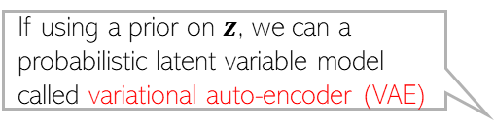



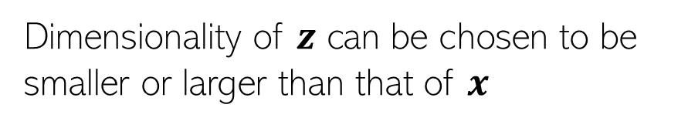

Auto-encoders
A special type of self-supervised learning: The whole input is being predicted by first compressing it and then uncompressing
8
Auto-encoders (AE) are used for unsupervised feature learning
Consist of an encoder $f$ and a decoder $g$
$f$ and $g$ can be deep neural networks (MLP, RNN, CNN, etc)
Note: Usually only the encoder is of use after the AE has been trained (unless we want to use the decoder for reconstructing the inputs later)
If using a prior on $z$, we can a probabilistic latent variable model called variational auto-encoder (VAE)
VAE can also generate synthetic data usings its decoder (standard AE’s decoder can’t generate “new” data)
$$\hat{x}=g(f\left(x\right))$$
Goal: Learn $f$ and $g$ s.t. $\left\|x −\hat{x}\right\|$ is small
$$z=f(x)$$
Dimensionality of $z$ can be chosen to be smaller or larger than that of $x$
If using AE for dimensionality reduction
Sometimes we want to learn “overcomplete” feature representations of the input
In such cases, need to impose additional constraints on $f$ so that we don’t learn an identify mapping from $x$ to $z$
$$f$$
$$g$$

Slide 9
Convolution-less Models for Images: ViT
9
Transformers can be used for images as well#. For image classification, it looks like this
Early work showed ViT can outperform CNNs given very large amount of training data
However, recent work* has shown that good old CNNs still rule! ViT and CNN perform comparably at scale, i.e., when both given large amount of compute and training data
Only the encoder part of the transformer needed
On the output side, we just need an MLP with softmax outout
Treat image patches as tokens of a sequence
Also use the position information
# An Image is Worth 16x16 Words: Transformers for Image Recognition at Scale (Dosovitskiy et al, 2020)
*ConvNets Match Vision Transformers at Scale (Smith et al, 2023)

Slide 10
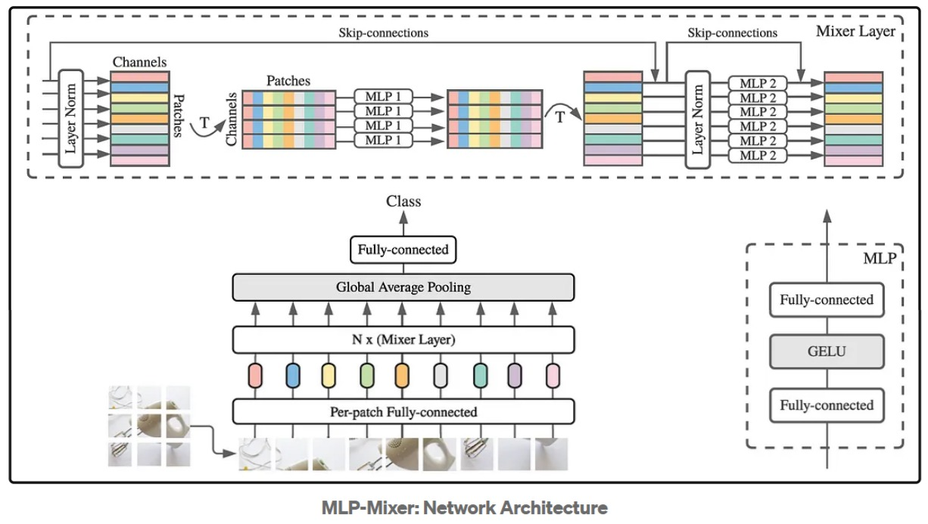
Convolution-less Models for Images: MLP-mixer
10
Many MLPs can be mixed to construct more powerful deep models (“MLP-mixer”)
‘T’ stands for Transpose
MLP-Mixer: An all-MLP Architecture for Vision (Tolstikhin et al, 2021)

Slide 11
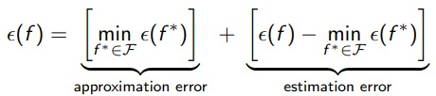
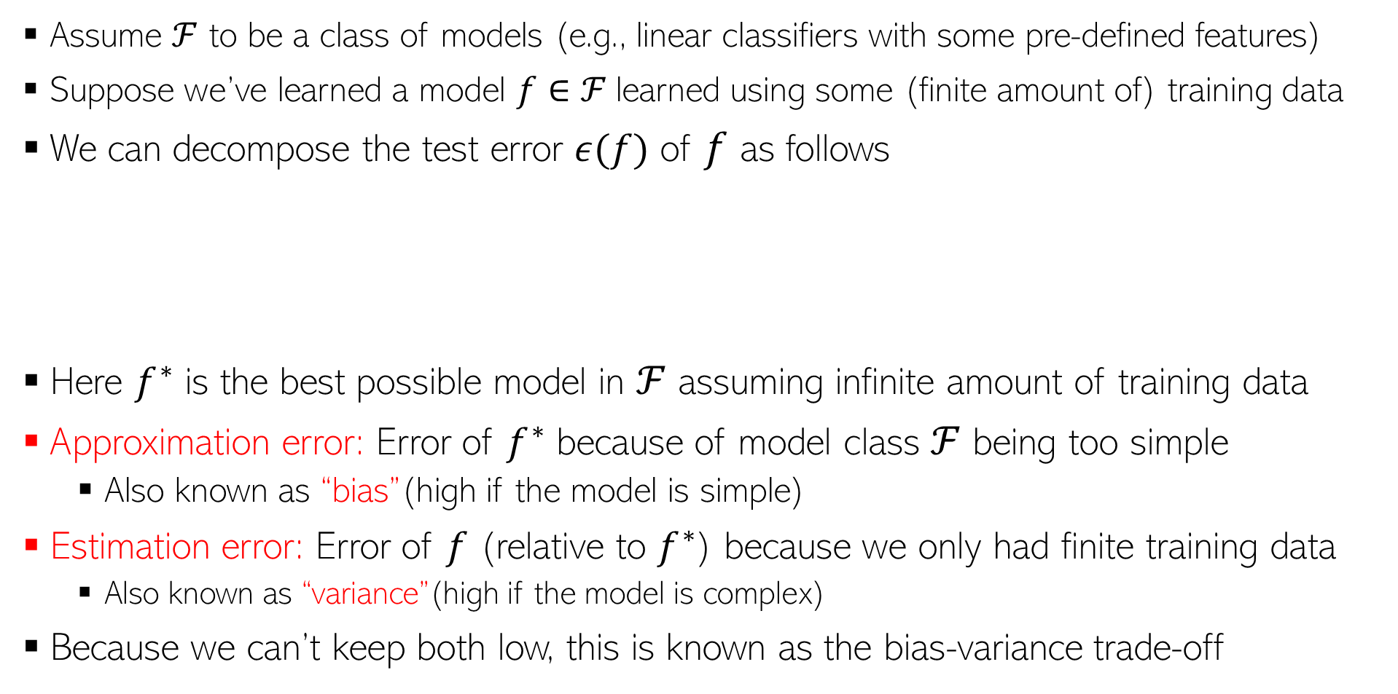


Bias-Variance Trade-off
11
Assume $ℱ$ to be a class of models (e.g., linear classifiers with some pre-defined features)
Suppose we’ve learned a model $f∈ℱ$learned using some (finite amount of) training data
We can decompose the test error $ε(f)$ of $f$ as follows
Here $f^{∗}$ is the best possible model in $ℱ$ assuming infinite amount of training data
Approximation error: Error of $f^{∗}$ because of model class $ℱ$ being too simple
Also known as “bias”(high if the model is simple)
Estimation error: Error of $f$ (relative to $f^{∗}$) because we only had finite training data
Also known as “variance”(high if the model is complex)
Because we can’t keep both low, this is known as the bias-variance trade-off
E.g., going from linear models to deep nets or by adding more features
Reason: We are now learning a more complex model using the same amount of training data
Can bias reduce by making class $ℱ$ richer
Making $ℱ$ richer will also cause estimation error to increase

Slide 12
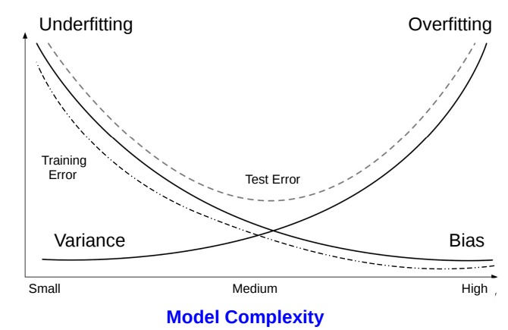
Bias-Variance Trade-off
12
Bias-variance trade-off implies how training/test losses vary as we increase model complexity

Slide 13
Deep Neural Nets and Bias-Variance Trade-off
13
Bias-variance trade-off doesn’t explain well why deep neural networks work so well
They have very large model complexity (massive number of parameters – massively “overparametrized”)
Despite being massively overparametrized, deep neural nets still work well because
Implicit regularization: SGD has noise (randomly chosen minibatches) which performs regularization
These networks have many local minima and all of them are roughly equally good
SGD on overparametrized models usually converges to “flat” minima (less chance of overfitting)
Learning of good features from the raw data
Ensemble-like effect (a deep neural net is akin to an ensemble of many simpler models)
Trained on very large datasets
Such a solution is less likely to be an overfitted solution because other nearby solutions are also reasonably good
A flat minima
Such minima are not good because they might represent an overfitted solution
A sharp minima
SGD because of the “noise” can escape such sharp minima

Slide 14
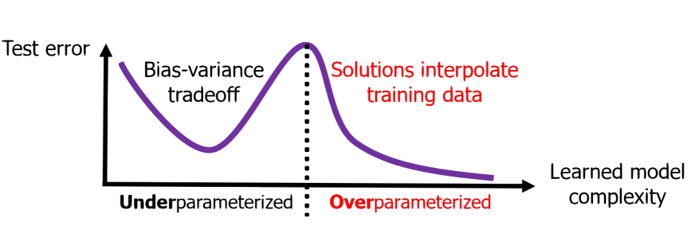
Double Descent Phenomenon
14
Overparametrized deep neural networks exhibit a “double descent” phenomenon
Bias-variance trade-off seen only in the underparametrized regime
Beyond a point (in the overparametrized regime), the test error starts decreasing once again even as the model gets more and more complex
Figure source: “A Farewell to the Bias-Variance Tradeoff? An Overview of the Theory of Overparameterized Machine Learning” (Dar et al, 2021)

Slide 15
Deep Neural Networks: A Summary
15

Slide 16
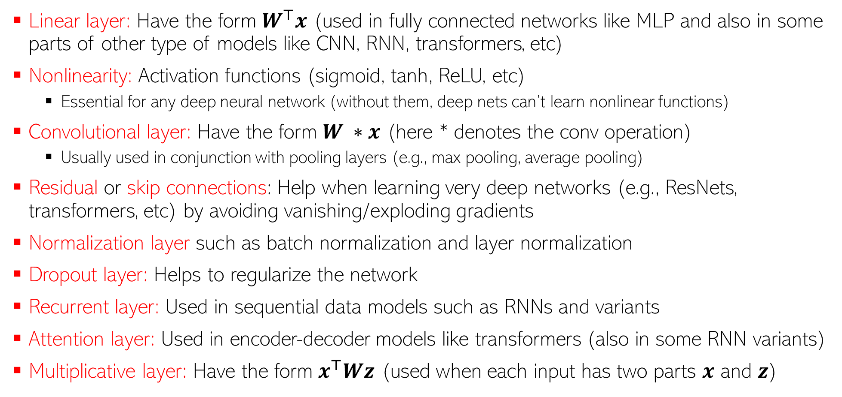
Common Types of Layers used in Deep Learning
16
Linear layer: Have the form $W^{⊤}x$ (used in fully connected networks like MLP and also in some parts of other type of models like CNN, RNN, transformers, etc)
Nonlinearity: Activation functions (sigmoid, tanh, ReLU, etc)
Essential for any deep neural network (without them, deep nets can’t learn nonlinear functions)
Convolutional layer: Have the form $W ∗x$ (here * denotes the conv operation)
Usually used in conjunction with pooling layers (e.g., max pooling, average pooling)
Residual or skip connections: Help when learning very deep networks (e.g., ResNets, transformers, etc) by avoiding vanishing/exploding gradients
Normalization layer such as batch normalization and layer normalization
Dropout layer: Helps to regularize the network
Recurrent layer: Used in sequential data models such as RNNs and variants
Attention layer: Used in encoder-decoder models like transformers (also in some RNN variants)
Multiplicative layer: Have the form $x^{⊤}Wz$ (used when each input has two parts $x$ and $z$)

Slide 17
Popular Deep Learning Architectures
17
MLP: Feedforward fully connected network
Not preferred when inputs have spatial/sequential structures (e.g., image, text)
Some variants of MLP (e.g., MLP-mix) perform very well on such data as well
CNN: Feedforward but NOT fully connected (but last few layers, especially output, are)
RNNs: Not feedforward (hidden state of one timestep connects with that of the next)
Transformers: Very powerful models for sequential data
Unlike RNNs, can process inputs in parallel. Also uses (self) attention to better capture long range dependencies and context in the input sequence
Graph Neural Networks: Used when inputs are graphs (e.g., molecules)
Autoencoders and Deep Generative Models: For unsupervised representation learning and synthetic data generation tasks

